Slide 1
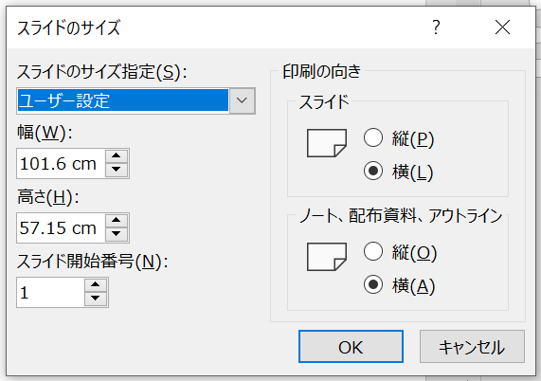
ポスター作成について／About Poster
■要件
①サイズ：101.6㎝ｘ57.15㎝（ワイド画面のデフォルトの３倍）
②枚数：１枚
※２ページ以降は「例」です
※Zoomで画面共有する際に拡大しないこと
■Specification
1. Size: 101.6㎝ｘ57.15㎝ / Aspect ratio(16:9) (default setting) x3
2. Page: １
※ ”Samples” from page 2
※ Share as it is (presenter should not zoom in)

Slide 2
P9-999
（60pt）
テザー型イリジウム協奏機能触媒による高効率なギ酸脱水素化反応
○吉田 実祈¹, 中村 仁美¹, 松並 明日香², 桑田 繁樹¹, 榧木 啓人¹
¹東京工業大学物質理工学院 ²青山学院大学理工学部
（Arial bold 66pt）
（40pt）
57.15㎝
（48pt）
（48pt）
A., Chem. Eur. J. 2015, 21, 13513.
Abstract
A bifunctional tethered iridium catalyst containing a 1,2- diphenylethylenediamine framework was synthesized for the first time. The ethereal tether chain was easily constructed via the intramolecular oxydefluorination of a perfluorophenylsulfonyl substituent by using a modified 1,2,3,4,5-pentamethylcyclopentadienyl ligand with a hydroxyalkyl chain. The conformationally constrained structure could hamper deactivation pathways in the catalytic hydrogen generation from formic acid, leading to advanced durability and complete conversion. (~100 words)
A., Chem. Eur. J. 2015, 21, 13513.
背景
（32pt）
This work
テザー型錯体の合成
〇協奏機能触媒によるギ酸脱水素化反応
〇FsDPENとの反応
New
dehydrogenation
catalyst
TON_{.1h}
（20pt）
1,823
「ファイル」−「ページ設定」でスライドのサイズ指定を
「ユーザ設定」にして
幅101.6 cm、高さ57.15 cmに設定。
図中のフォントサイズは目安。18-20pt以上が望ましい。
〇TfDPENとの反応
524
Concise synthesis
53
Efficient H₂ evolution
from formic acid
A. Matsunami, Y. Kayaki, T. Ikariya, Chem. Eur. J. 2015, 21, 13513.
Robustness
（24pt）
X線結晶構造
触媒的脱水素化反応
まとめ
〇高効率な水素発生
〇錯体1と3の比較
文字サイズ例（20pt）
Examples (20 pt)
・High activity at
ambient temperature
TOF up to 5,000 h⁻¹
文字サイズ例（18pt）
Examples（18pt）
・Long-term stability
TON above 80,000
TON_{90 min}
TOF_{5 min}/h⁻¹
謝辞
101.6㎝
2,650
663
This work was supported by JSPS KAKENHI Grant Numbers JPxxxxxxx.

Slide 3
P9-999
（60pt）
Dehydrogenation of Formic Acid with Tethered Bifunctional Iridium Catalysts
○Minori Yoshida,¹ Hitomi Nakamura,¹ Asuka Matsunami,² Shigeki Kuwata,¹ Yoshihito Kayaki¹
¹School of Materials and Chemical Technology Tokyo Institute of Technology, ²College of Science and Engineering, Aoyama Gakuin University
（40pt）
（Arial bold 66pt）
（48pt）
Backgrounds
A., Chem. Eur. J. 2015, 21, 13513.
Abstract
A bifunctional tethered iridium catalyst containing a 1,2- diphenylethylenediamine framework was synthesized for the first time. The ethereal tether chain was easily constructed via the intramolecular oxydefluorination of a perfluorophenylsulfonyl substituent by using a modified 1,2,3,4,5-pentamethylcyclopentadienyl ligand with a hydroxyalkyl chain. The conformationally constrained structure could hamper deactivation pathways in the catalytic hydrogen generation from formic acid, leading to advanced durability and complete conversion. (~100 words)
A., Chem. Eur. J. 2015, 21, 13513.
Synthesis of tethered complexes
（32pt）
This work
〇Dehydrogenation of formic acid with bifunctional catalysts
〇Reaction with FsDPEN
57.15㎝
New
dehydrogenation
catalyst
TON_{.1h}
（20pt）
1,823
Please set the page size to “user setting” with 101.6 x 57.15 cm in
“File”–”Page Setting”
The font size should be 18-20pt or larger.
〇Reaction with TfDPEN
524
Concise synthesis
53
Efficient H₂ evolution
from formic acid
A. Matsunami, Y. Kayaki, T. Ikariya, Chem. Eur. J. 2015, 21, 13513.
Robustness
（24pt）
X-ray structures
Catalytic H₂ evolution
Summary
〇Efficient H₂ evolution
〇Comparison of 1 and 3
Examples (20 pt)
・High activity at
ambient temperature
TOF up to 5,000 h⁻¹
Examples (18pt)
・Long-term stability
TON above 80,000
TON_{90 min}
TOF_{5 min}/h⁻¹
Acknowledgments
101.6㎝
2,650
663
This work was supported by JSPS KAKENHI Grant Numbers JPxxxxxxx.

